Slide 1
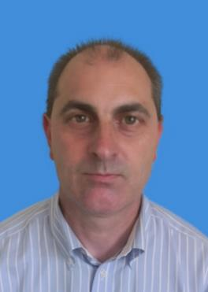
Research Interests:
Digital Health Technologies
ICT4HOP’16 and’17 Workshop Co-Chair
Smart Homes and Cities
Next Generation Mobile Systems
Emergency and Disaster Relief Communications
Satellite Systems and Applications
Social Media
Linkedin: https://www.linkedin.com/in/raysheriff/
Researchgate: https://www.researchgate.net/profile/Ray_Sheriff
Twitter: @RayES1
Prof Ray Sheriff
ICT4AID Workshop Co-Chair
Email: resheriff@outlook.com
Wechat: raysheriff

Slide 2
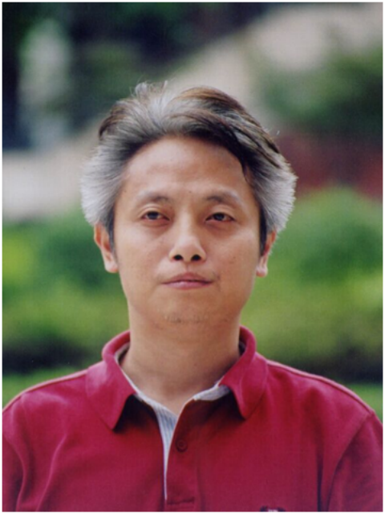
Research Interests:
Digital Image Processing
Pattern Recognition
Image Communication
Intelligent Monitoring System
Communication and Information System
Contact Details
Tel.: +0086 13708013093
hxh@scu.edu.cn
Social Media
http://eie.scu.edu.cn:82/scuimage/
http://eie.scu.edu.cn/TeacherDetail.aspx?id=37
Professor Xiaohai He
College of Electronics and Information Engineering, Sichuan University
Chengdu, China

Slide 3

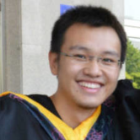
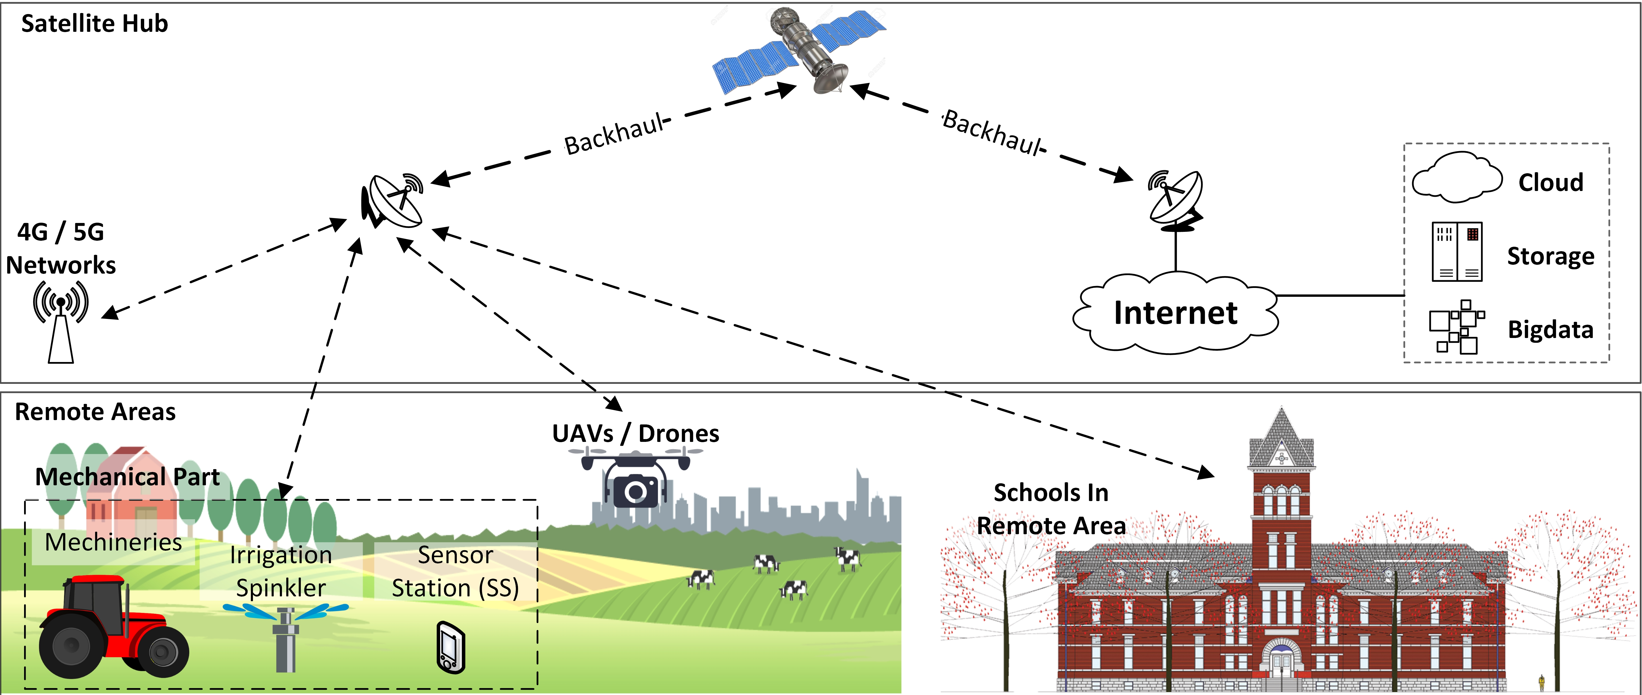
My current research interests are privacy and security issues in vehicular communication networks, as well as cross-network scenarios:
Privacy and security services for the location-based services between vehicular communication networks and other IoT scenarios.
The satellite-based delay-tolerant network that supports the vehicular communication services in remote areas.
Ao Lei
Research Fellow
Contact Details
Tel.: +44 (0)7482378121
Email: ao.lei@surrey.ac.uk
mcclion@gmail.com
Wechat: mcclion0121
Social Media
Linkedin: Just search Ao Lei

Slide 4
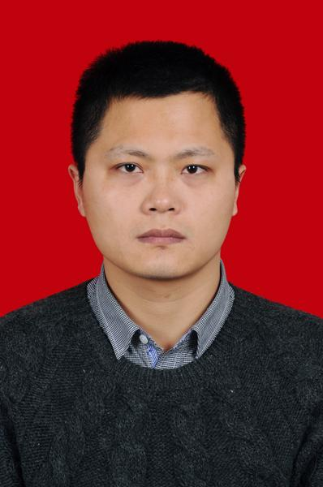
Research Interests:
Intelligent monitoring of urban underground pipe network
Underwater acoustic communication
Industrial internet of things
Intelligent instrument design
Information acquisition and processing
Contact Details
Tel.: +0086 13594356083
lishuaiyong@cqupt.edu.cn
Social Media
http://iot.cqupt.edu.cn/info/1087/1179.htm
http://ac.cqupt.edu.cn/info/1052/1885.htm
Dr. Shuaiyong Li
College of Automation, Chongqing University of Posts and Telecommunications, Chongqing, China

Slide 5
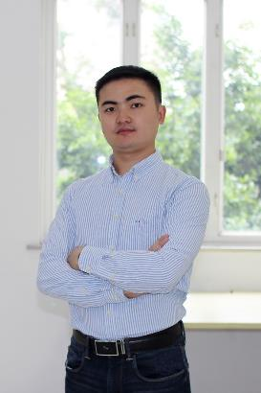
Research Interests:
Wireless Communications
Network Coding
Resource Allocation
Contact Details
Tel.: +86 8540 3266
lyhuang@scu.edu.cn
Dr. Linyu Huang
College of Electronics and Information Engineering
Sichuan University
Chengdu, Sichuan, P. R. China

Slide 6


Research Interests
Early career researcher focused on the use of remote sensing for hazard assessment, in particular, geological hazards.
On-going research activities involve identifying precursory indicators of activity and monitoring the progression of hazard events to ensure adequate detection and warning in hazard-prone areas.
Specific interests: hazard assessment, remote sensing, risk communication and early warning.
Contact Details
Email: charley.hill-butler@coventry.ac.uk
Tel: 02477 659141
Social Media
Twitter: @CHillButler
Linkedin: https://uk.linkedin.com/in/charley-hill-butler-04487643
Researchgate: https://www.researchgate.net/profile/Charley_Hill-Butler
Dr Charley Hill-Butler
Lecturer in Physical Geography and Natural Hazards

Slide 7
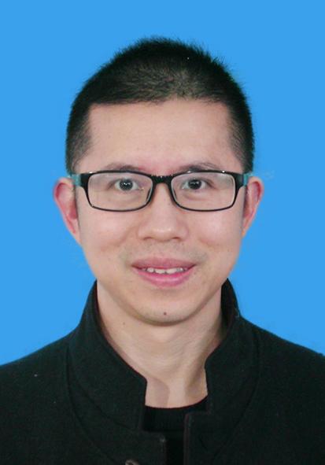
Research Interests:
Evidence based policy making and management
Healthcare innovation
Lean and healthcare quality improvement
Performance assessment
Data mining
Contact Details
Tel.: +86 18980606225
huaxiwenjin@163.com
Associate Professor Jin WEN
Institute of Hospital Management
West China Hospital, Sichuan University
Chengdu, Sichuan, China

Slide 8

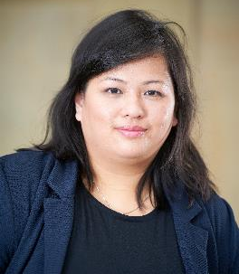
Research Interests:
AI systems
Machine Learning
Embedded Systems/ Health Care Technologies
Next Generation Mobile Systems
Neural Networks
Education Research
Mobile Applications
Robotic Systems
Internet-of-Things
Mobility Management
Wireless Communications
Contact Details
Tel.: +44 (0)1204 903397
f.ong@bolton.ac.uk
Wechat ID: fel_ong
Dr Felicia Li Chin Ong
BEng (Hons) PhD PGCHE MIET FHEA
Lecturer in Electrical and Electronic Engineering
School of Engineering
Social Media
https://uk.linkedin.com/in/felicia-ong
https://www.researchgate.net/profile/Felicia_Ong

Slide 9
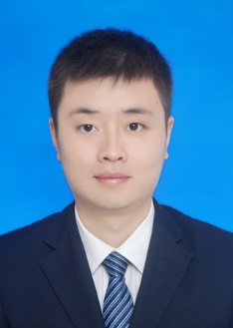
Research Interests:
Application of Optoelectronic Technology in Geosciences
Optical Frequency Conversion
Laser
Contact Details
Tel.: +0086 13550342056
yinmingcdut@163.com
Associate Professor Ming Yin
College of Information Science & Technology, Chengdu University of Technology
Chengdu, China

Slide 10

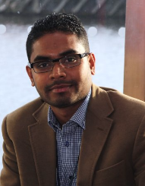

Research Interests:
Disaster resilience, property-level flood adaptation, resilience of SMEs, procurement in construction
Contact Details
Email: gayan.wedawatta@Northumbria.ac.uk
Wechat: gayan.wedawatta
Social Media
Linkedin: https://uk.linkedin.com/in/gayan-wedawatta-b4a70829
Google scholar: http://scholar.google.com/citations?user=J3s4APQAAAAJ&hl=en
Name: Gayan Wedawatta
Position: Senior Lecturer

Slide 11
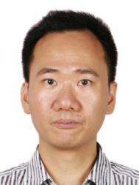
Research Interests:
Image Processing
Computer Vision
Pattern Recognition
Machine Learning
Contact Details
Tel.: +86 (028)83035459
toddjiang@163.com
QQ: 196518266
Lecturer Jun Jiang
School of Computer Science
Southwest Petroleum University
Chengdu, Sichuan, China

Slide 12

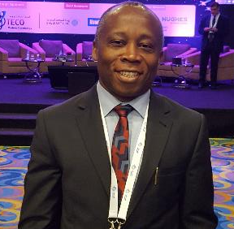
Research Interests:
5G and Satellite Systems Integration
Fade and Interference Mitigation
Bandwidth & Energy Efficient Modulation and Coding Schemes
Propagation and Link Modelling
Contact Details
Tel.: +44 1443 482971
Email: ifiok.otung@southwales.ac.uk
Wechat: wxid_mabjk0vknac222
Social Media
Linkedin
Researchgate
Dr Ifiok Otung
Professor of Satellite Communications

Slide 13
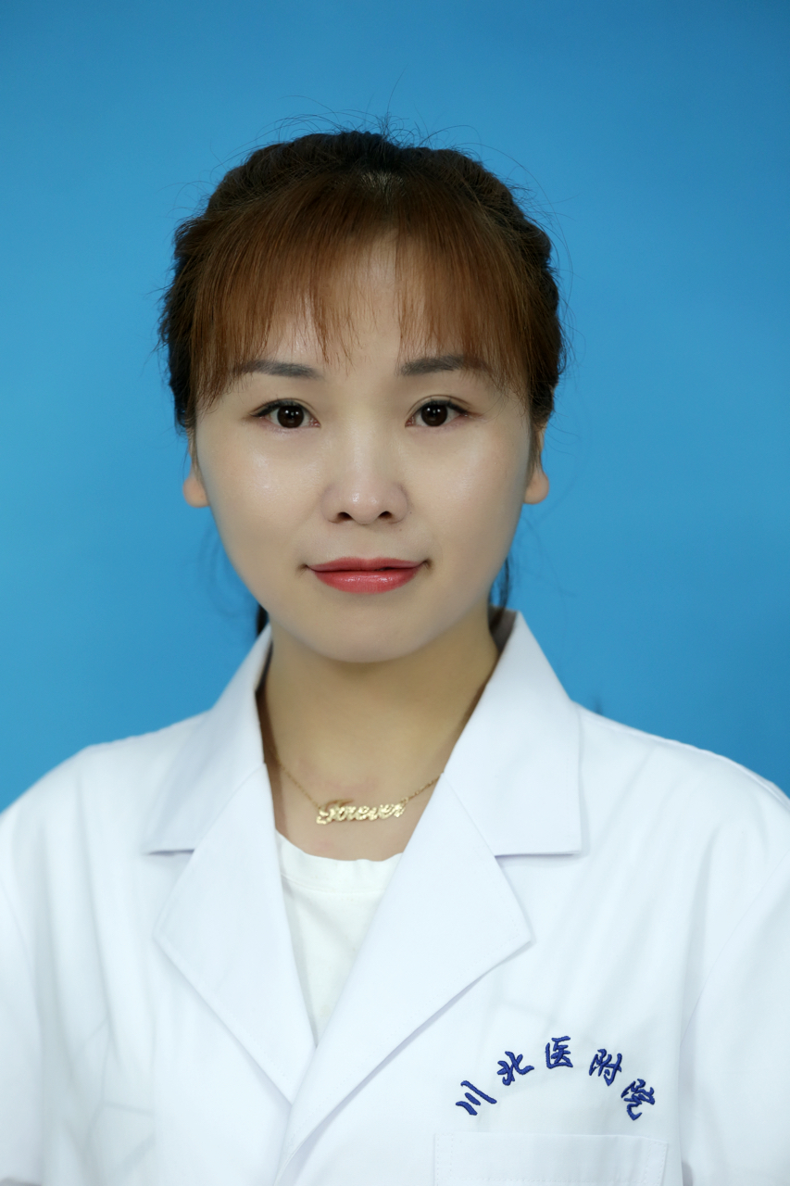
Research Interests
Ultrasound medical imaging
Molecular imaging
Health management
Ultrasound contrast agent
Contact Details
Tel.: +86 13990859023
525293623@qq.com
Dr Jin Hong Yu, associate professor
School of Medical Imaging
North Sichuan Medical College
Nanchong, Sichuan, China

Slide 14
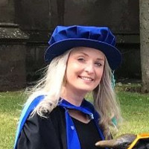
Research Interests:
Early Career Human Geographer specialising in:
International Development
Social Research Methods
Social Inequalities and Marginalisation
Disaster Risk Reduction
Contact Details:
Tel.: +44 2477654540
Email: jade.catterson@coventry.ac.uk
Social Media:
Twitter: @Jade_Catterson
Linkedin: https://www.linkedin.com/in/jade-catterson-76bab363/
Research Gate: https://www.researchgate.net/profile/Jade_Catterson
Dr Jade Catterson
Assistant Lecturer in Human Geography

Slide 15
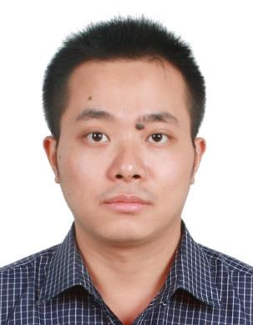
Research Interests:
Digital Image Processing
Pattern Recognition
Machine Learning
Computer Vision
Contact Details
Tel.: +0086 18680754875
qianjiye@cqu.edu.cn
Social Media
http://qianjiye.de
http://scholar.google.com/citations?user=vKFaAvMAAAAJ
Postdoc Jiye Qian
School of Automation
Chongqing University
Chongqing, China

Slide 16

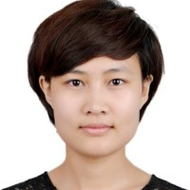
Research Interests:
Steel and Composite structures
Demountable/Reusable structures
Fire behaviour
Seismic performance
Sustainability
Contact Details
Email: j.yang17@bradford.ac.uk
Wechat: jieyang14
Social Media
LinkedIn:
https://www.linkedin.com/in/jie-yang-a3706ab8
Researchgate
https://www.researchgate.net/profile/Jie_Yang117
Name: Jie Yang
Position: Post-doc Research Assistant

Slide 17
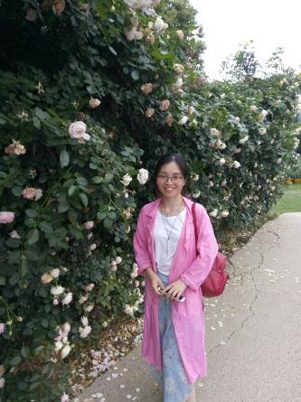
Dr. Junfang Cui
Institute of Mountain Hazards and Environment, Chinese Academy of Sciences,
Chengdu, China
Research Interests:
Soil structure
Physical protection of soil organic matter
Hydrology in mountain area
Contact Details
Tel.: +008618708183023
Email: jfcui@imde.ac.cn

Slide 18
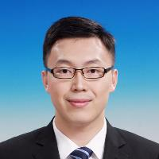
Research Interests:
Steel- concrete composite structures
Fire behaviour of composite structures
Circular economy
Contact Details
Email: k.zhou1@bradford.ac.uk
WeChat: wfdln08
Social Media
LinkedIn:
https://www.linkedin.com/in/kan-zhou-b72503116/
ResearchGate
https://www.researchgate.net/profile/Kan_Zhou4
Your Name: Kan Zhou
Position: Post-doc Research Assistant

Slide 19
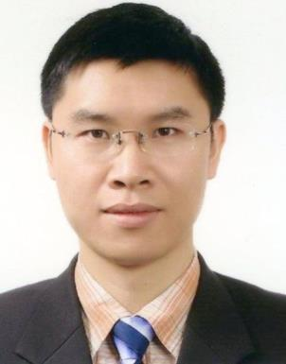
Research Interests:
Hologram 3D display
Computer generated hologram
Image encryption
Image/video compression
GPU based parallel computing
Contact Details
Tel.: +86 151 96672467
jwang@scu.edu.cn
Social Media
QQ: 7710562; Weichat: jwang_scu
http://eie.scu.edu.cn/info/1046/4725.htm
Associate Professor Jun WANG
College of Electronics and Information Engineering, Sichuan University
Chengdu, China

Slide 20



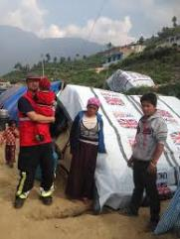
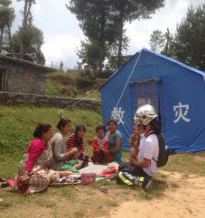
RESEARCH INTERESTS:
Local disaster risk governance -(Integrated disaster vulnerability and capabilities analysis)
Multi-Agency Collaboration- Science and technology based collaborative local disaster risk and safety communication.
Hybrid risks analysis;
Mapping cascading impacts of disasters;
Heritage based livelihoods safety and management.
CONTACT DETAILS
Tel: +447443543151
Email: k.r.aryal18@salford.ac.uk
Wechat: local disaster
SOCIAL MEDIA
Linkedin: https://www.linkedin.com/in/dr-komal-raj-aryal-65281b41/
Website: https://www.salford.ac.uk/thinklab/people/komal-raj-aryal
Name: Dr. Komal Raj Aryal
Position: Research Fellow / Community Volunteer, TWFRS UK

Slide 21
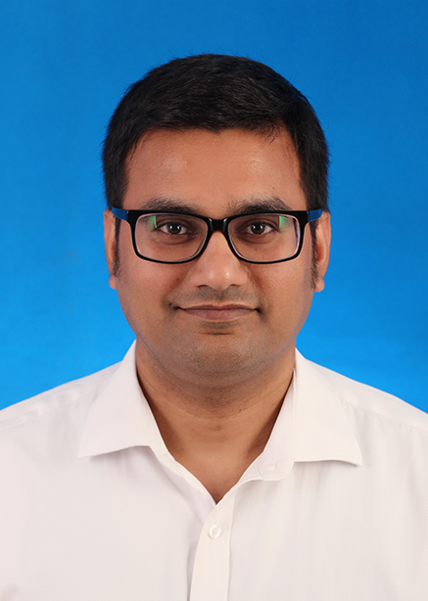
Research Interests:
Digital Image Processing
Pattern Recognition
Computer Vision and Image Communication
Contact Details
Tel.: +0086 13266825190
prkarn@scu.edu.cn
PhD Pradeep Karn
College of Electronics and Information Engineering,
Sichuan University, Chengdu, China

Slide 22



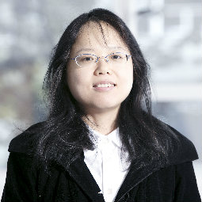
Research Interests:
Data communication in IoT
Data analytics
Optimization
Environmental applications
Current project:
Innovate UK KTP
Contact Details
Tel.: +44 191 243 7613
nanlin.jin@northumbria.ac.uk
Social Media
https://www.northumbria.ac.uk/about-us/our-staff/j/nanlin-jin/
https://www.linkedin.com/in/nanlin-jin-b71514140/
Dr Nanlin Jin
Computer and Information Sciences
Northumbria University,
Newcastle, UK

Slide 23
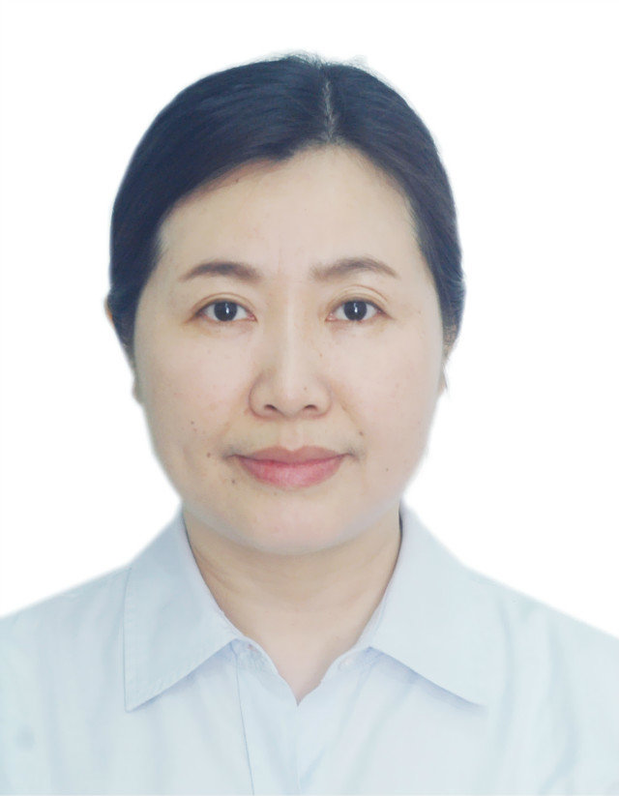
Research Interests:
Digital Medicine
Radiology
Ultrasonic Medicine
Medical Education and Administrative Management
Contact Details
Tel.: +86 13550022152
wuyinghua_1111@163.com
Social Media
http://www.cdutcm.edu.cn/index.html
Professor Yinghua Wu
Director of Sichuan GP training Center
Chengdu University of Traditional Chinese Medicine
Chengdu, Sichuan, China

Slide 24

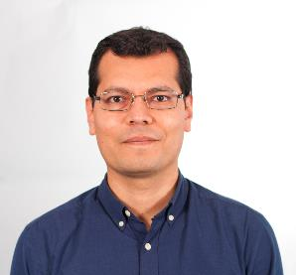

Research Interests:
Earthquake engineering, earthquake risk management, FRP composites in construction, structural strengthening, experimental techniques
Contact Details
​Sir Frederick Mappin Building, Mappin St., Sheffield, S1 3JD, UK
T. +44 (0) 114 222 5071
E. r.garcia@sheffield.ac.uk
E. reyesgl@gmail.com (preferred)
Social Media
W: https://cee.sheffield.ac.uk/people/dr-reyes-garcia
Linkedin: https://www.linkedin.com/in/garciareyes/
RG: https://www.researchgate.net/profile/Reyes_Garcia2
Reyes Garcia
Post-Doctoral Research Associate
From October: Assist. Professor
at the University of Warwick.

Slide 25
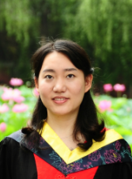
Research Interests:
Digital Image Processing
Intelligent Video Analysis
Pattern Recognition
Contact Details
Tel.: +0086 18602898566
wuyuanyuan@cdut.edu.cn
Yuanyuan Wu
College of Information Science and Technology, Chengdu University of Technology, Chengdu, China

Slide 26
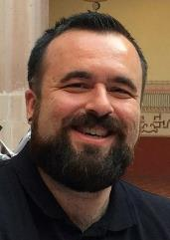


Employing ICT for Mountainous Rural Community Relief from Natural Disasters Chengdu, China, 27 – 29 August 2018
Richard David Evans
Position: Senior Lecturer in Information Management
University: University of Westminster, London UK
E-mail: R.Evans@Westminster.ac.uk
ResearchGate: https://www.researchgate.net/profile/Richard_Evans20
LinkedIn: http://uk.linkedin.com/in/ecommercespecialists
PhD in Knowledge Management for Collaborative Product Development
BAE Systems and University of Greenwich (EPSRC Industrial Case Award)
MSc in e-Commerce, University of Wales
BA (Hons.) in Computing, University of Exeter
Editorial Board Member for the IEEE Trans. on Engineering Management
Chair of the IEEE TEMS TAC on Engineering Processes
Regular reviewer for numerous journals and conferences
Knowledge Management and Innovation in NPD
Social Product Development and Open Innovation
Distributed Collaboration using Web-based Systems
+44 07875523209

Slide 27
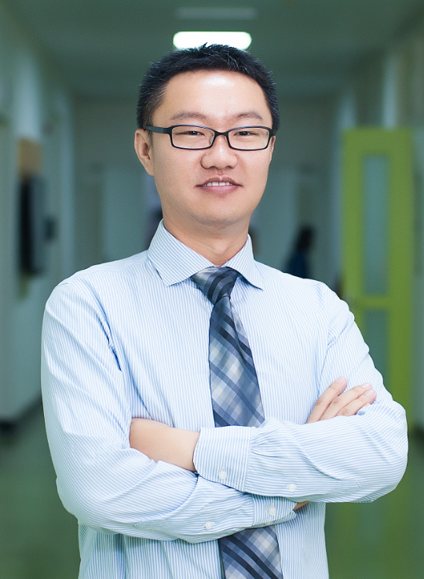
Research Interests:
Microwave Generator
Microwave Power Combining
RF Circuits Design
Antenna Design
Permittivity Measurement
Contact Details
Tel.: +0086 15281058298
yyang@scu.edu.cn
Social Media
http://eie.scu.edu.cn/info/1046/4717.htm
Associate Professor Yang Yang
College of Electronics and Information Engineering, Sichuan University
Chengdu, China

Slide 28

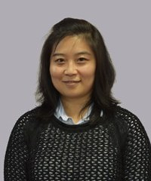
Your Institution’s Logo
Research Interests:
Face modelling
Facial feature localisation
Face recognition verification
Facial expression analysis
Gender classification
Contact Details
Tel.: +44 23 9284 2096
xia.han@port.ac.uk
Xia Han
Computing Tutor

Slide 29
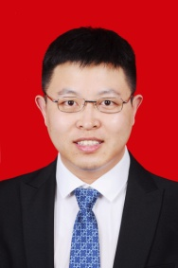
Research Interests:
Energy Harvesting
Conditioning Circuit
Self-powered Sensors
Wireless Sensor Networks
Contact Details
Tel.: +0086 13527514021
zhangjj@cqupt.edu.cn
Lecturer Jiajia Zhang
College of Automation, Chongqing University of Posts and Telecommunications,
Chongqing, China

Slide 30

Dr Xiaogang (John) Shi
Lecturer in Hydrology, Lancaster Environment Centre
Associate Director, Lancaster University China Centre
Dr Xiaogang (John) Shi
Senior Lecturer in Hydrology (from 2018/10/01)
School of Interdisciplinary Studies

Slide 32
Contact Details
Email: xiaogang.shi@lancaster.ac.uk
Wechat: uwhydro86
Tel: +44 (0)1524 593966
Social Media
LinkedIn
ResearchGate

Slide 33
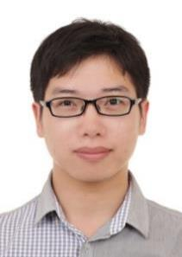
Research Interests:
Optical Engineering
Inertial Confinement Fusion
Ultra-short Pulse Technology
Adaptive Optics
Contact Details
Tel.: +0086 15982389074
scuzhongzq@163.com
Social Media
To be completed.
Assistant Prof. Zheqiang Zhong
College of Electronics and Information Engineering, Sichuan University
Chengdu, China

Slide 34

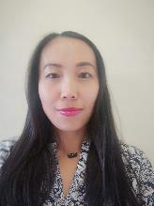
Research Interests:
Advanced Materials for Healthcare
Digital Health Technologies
Business Research in cross country collaborations
Contact Details
Tel.: +44 1274234034
Email: xwang5@Bradford.ac.uk
Wechat: treebud
Social Media
https://www.linkedin.com/in/xlwang
Name: Xiaolei Wang
Position: International Collaboration Manager Polymer Interdisciplinary Research Centre

Slide 35

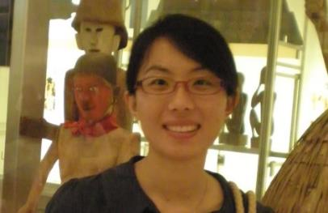
Research Interests:
Ecosystem based disaster reduction
Critical infrastructure resilience
Soil dynamics
Contact Details
Tel.: +44 (0) 24 765 24737
Email: xueyu.geng@warwick.ac.uk
Wechat: ozprincess
Web: https://warwick.ac.uk/fac/sci/eng/staff/xg/
Social Media
Linkedin: Xueyu Geng
Researchgate:Xue-yu Geng
Name: Dr. Xueyu Geng
Position: Assistant Professor

Slide 36
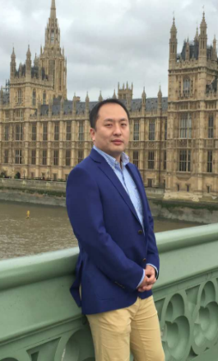
Research Interests:
3D Modeling
3D Face Recognition
Biometrics
Image Processing
Machine Learning
Contact Details
Tel.: +86 180 8085 5278
yinjie@scu.edu.cn
Social Media
https://www.researchgate.net/profile/Yinjie_Lei
Dr Yinjie Lei
College of Electronics and Information Engineering
Sichuan University
Chengdu, Sichuan, China

Slide 37
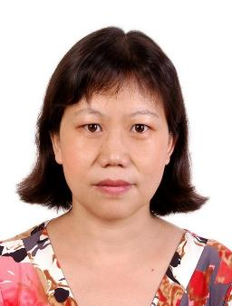
Research Interests:
Digital Image Processing
Pattern Recognition
Computer Vision
wireless communication
Contact Details
Tel.: +0086 13438240631
wxh@scu.edu.cn
Assoc. Prof Xiaohong Wu
College of Electronics and Information Engineering,
Sichuan University, Chengdu, China

Slide 38
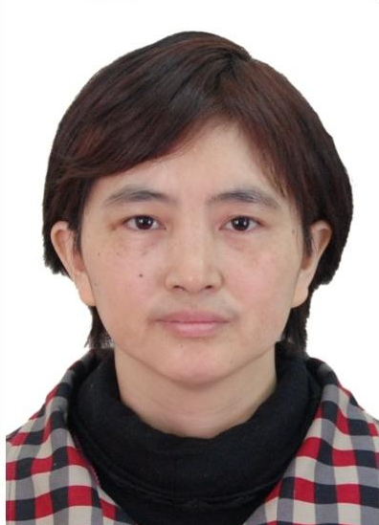
Research Interests:
Circuit and System
Digital Image Processing and Pattern Recognition
Intelligent System Design
Contact Details
Tel.: +0086 13666121513
wangzheny@scu.edu.cn
Social Media
http://eie.scu.edu.cn/info/1046/4746.htm
Associate Professor Zhengyong Wang College of Electronics and Information Engineering, Sichuan University
Chengdu, China

Slide 39
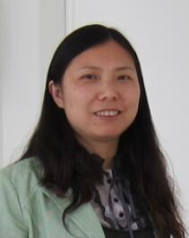
Research Interests:
Image and Video Processing
Image and Video Communication
Image Data Hiding
Contact Details
Tel.: +86 13678115569
Email: yuyanmei@scu.edu.cn
Associate Professor Yanmei YU
College of Electronics and Information Engineering
Sichuan University , Chengdu, China

Slide 40
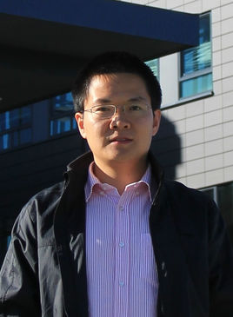
Research Interests:
Image Processing
Image/Video Communication
Pattern Recognition
Multimedia Sensor Networks
Embedded System Design for Image
Contact Details
Tel.: +86 13880789330
qing_lb@scu.edu.cn
Skype: Linbo_Qing
Social Media
http://eie.scu.edu.cn/TeacherDetail.aspx?id=38
http://www.linkedin.com/in/linbo-qing
Associate Professor Linbo Qing
College of Electronics and Information Engineering
Sichuan University
Chengdu, Sichuan, China

Slide 41
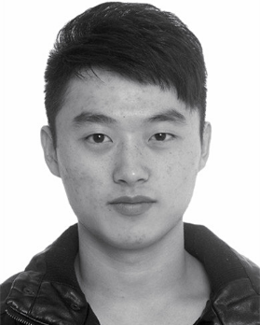
Research Interests:
Image and Video Processing
Inverse Problems Solving
Professional Activities:
Review for about 10 journals/ conferences, e.g., IEEE Trans. Image Process., Neurocomputing, etc.
Outstanding reviewer award from Elsevier
Contact Details
Tel.: +0086 18010681695
chaoren@scu.edu.cn
Associate Researcher Chao Ren
College of Electronics and Information Engineering, Sichuan University
Chengdu, China
Homepage
http://sites.google.com/site/chaorenhomepage

Slide 42
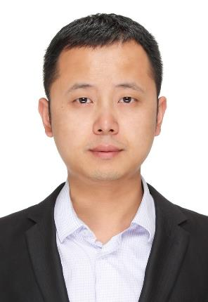
Research Interests:
Wireless Power Transfer
Microwave Components and System
Contact Details
Tel.: +0086 15108303574
chengfei@scu.edu.cn
Study Experience
2009 Xidian University Bachelor
2015 University of Electronic Science and Technology of China & University of Birmingham Phd
Research Assistant Fei Cheng
College of Electronics and Information Engineering, Sichuan University
Chengdu, China

